Slide 1

SOBHA ACCEPTABLE QUALITY LEVEL (SAQL)
Document Title : | Paint
Document Number : | SCL-SAQL-001
Date of Origin : | 08.05.2026
Date of Revision :
Revision Number : | 00
 | PREPARED BY | REVIEWED BY | REVIEWED BY | APPROVED BY | APPROVED BY | APPROVED BY | APPROVED BY
NAME | Mr. Sathishkumar Ravisankar | Mr. Rajeshkumar Lakshmanan | Mr. Thangapandi Rathinam | Mr. Suleyman Celik | Mr. Ayaz Siddiqui | Mr. Senthil Kumar Parasuraman | Mr. Karthikraj Rajendran
SIGNATURE
DATE

Slide 2
AMENDMENT SHEET
DATE OF REV | SUBJECT OF THE AMENDMENT | REV. NO.
08/05/2026 | New release | 00

Slide 3
OBJECTIVES
OBJECTIVE | The objective of this guideline is to provide a standard procedure for Paint Application Acceptable levels according to the Zones.
SCOPE | This document is valid for Paint Application Aesthetics Acceptance.
RESPONSIBLE | Site execution shall strictly adhere to the approved standards. QA/QC and QCS shall use these standards for inspection.
TERMS & REFERENCES | The QM / BE team shall be responsible for revising and updating the applicable standards as required.

Slide 4
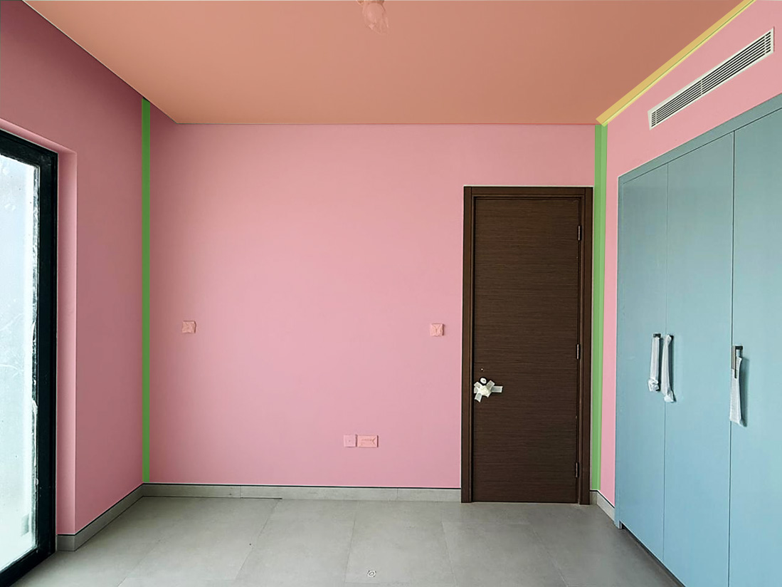
CATEGORIZATION / ZONES
= Ceiling
= Wall
= Corners
= Bulkhead
= Shadow Groove

Slide 5
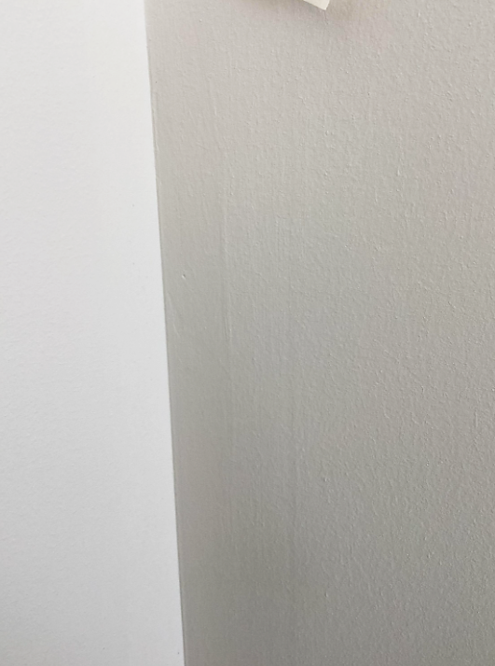
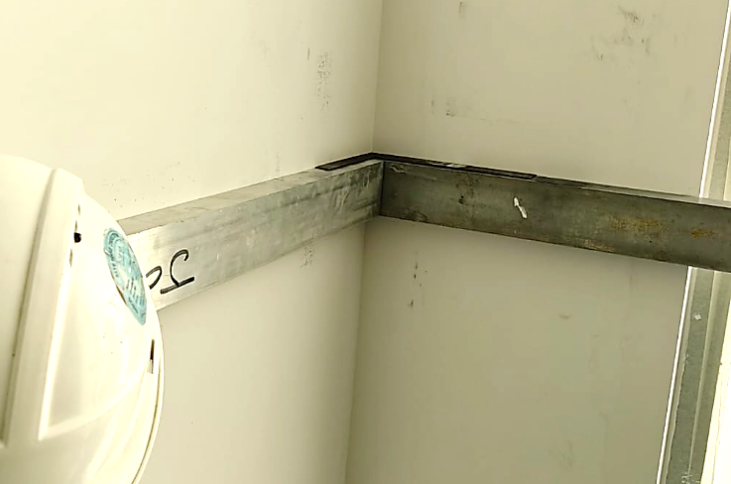
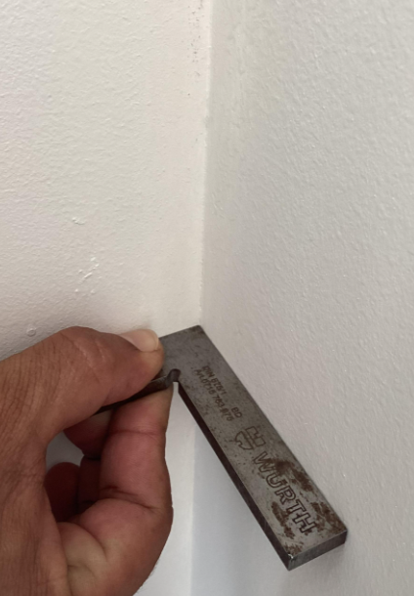
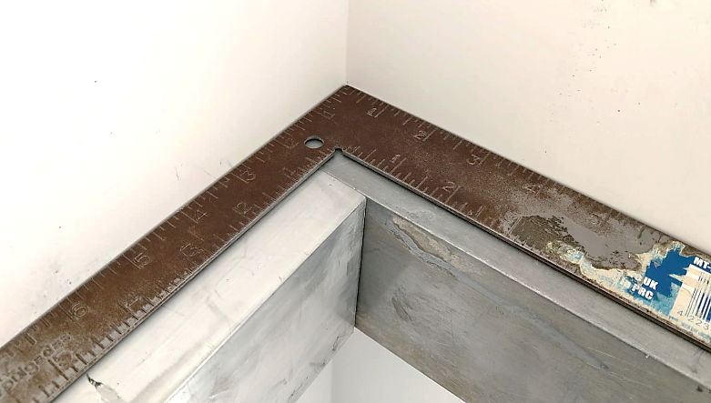
PAINT - SAQL
DEFECT DESCRIPTION / PARAMETER |  |  | Paint Corner Right Angle
DEFECT IMAGE / PARAMTER |  |  | MEASURING METHOD
 |  |  | INSTRUMENT / INSPECTION METHOD |  | Right angle scale & Straight Edge
 |  |  | STANDING POSITION |  | As required
APPLICABILITY |  VILLA  APARTMENT |  | LIGHTING |  | Natural / Ambient light / Artificial Light
ACCEPTABLE QUALITY LEVEL
SCENARIO / LOCATION / ZONE | Wall | Ceiling | Corners | Shadow Groove | Bulkhead | Cove Light
ACCEPTANCE LIMIT | 1mm | 1mm | 1mm | 1mm | 1mm | NA
REMARKS
Steps :
Place both 3-meter straight edge flush to the corner.
Set the right‑angle square on top, firmly seated at the corner.
Check the corner for squareness, any gap or misalignment
Time of inspection: Before application of the first coat of paint.
Ceiling to Wall
Wall to Wall
“Note: During keep-out inspection in case of any visual discrepancy identified, measurement verification shall be carried out based on the SAQL.”

Slide 6
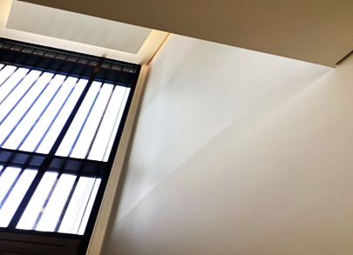
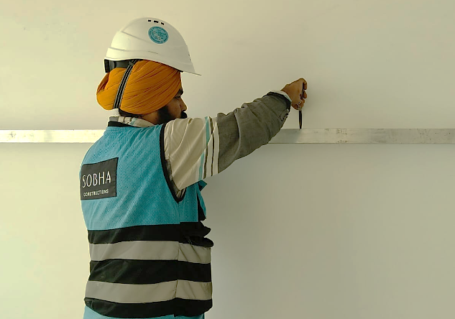
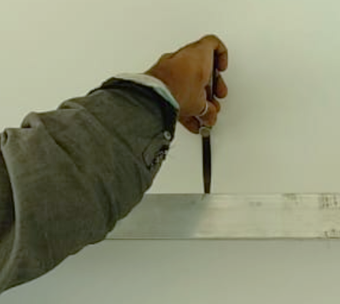
PAINT - SAQL
DEFECT DESCRIPTION / PARAMETER |  |  | Paint Undulation
DEFECT IMAGE / PARAMTER |  |  | MEASURING METHOD
 |  |  | INSTRUMENT / INSPECTION METHOD |  | Straight Edge & Feeler gauge
 |  |  | STANDING POSITION |  | As required
APPLICABILITY |  VILLA  APARTMENT |  | LIGHTING |  | Natural / Ambient light / Artificial Light
ACCEPTABLE QUALITY LEVEL
SCENARIO / LOCATION / ZONE | Wall | Ceiling | Corners | Shadow Groove | Bulkhead | Cove Light
ACCEPTANCE LIMIT | 1.5 mm every 3 meter (No Waviness) | 1.5 mm every 3 meter (No Waviness) | 1.5 mm every 3 meter (No Waviness) | 1.5 mm every 3 meter (No Waviness) | NA | 1.5 mm every 3 meter (No Waviness)
REMARKS
Steps :
Place the 3-meter straight edge flat against the surface, ensuring there is no tilt or lifting.
Insert the feeler gauge blade into any visible gap between the straight edge and the surface.
Check the measurement along the entire length.
Time of inspection: Before application of the first coat of paint.
“Note: During keep-out inspection in case of any visual discrepancy identified, measurement verification shall be carried out based on the SAQL.”

Slide 7
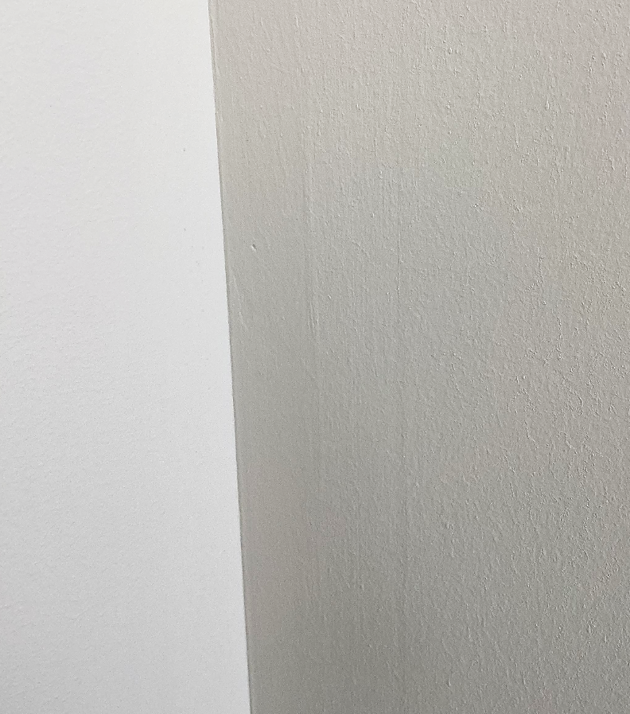
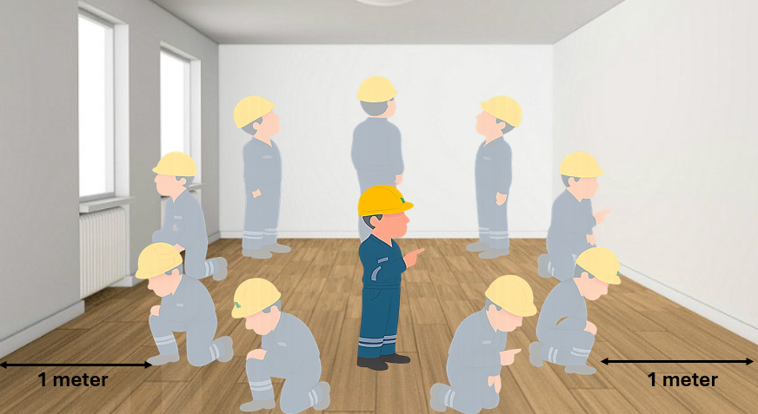
PAINT - SAQL
DEFECT DESCRIPTION / PARAMETER |  |  | Paint Improper Sanding Mark Visibility
DEFECT IMAGE / PARAMTER |  |  | MEASURING METHOD
 |  |  | INSTRUMENT / INSPECTION METHOD |  | Visual Inspection
 |  |  | STANDING POSITION |  | Minimum 1 Meter in any direction.
APPLICABILITY |  VILLA  APARTMENT |  | LIGHTING |  | Natural / Ambient light / Artificial Light
ACCEPTABLE QUALITY LEVEL
SCENARIO / LOCATION / ZONE | Wall | Ceiling | Corners | Shadow Groove | Bulkhead | Cove Light
ACCEPTANCE LIMIT | Not visible from 1 meter at any angle | Not visible from 1 meter at any angle | Not visible from 1 meter at any angle | Not visible from 1 meter at any angle | Not visible from 1 meter at any angle | NA
REMARKS
Visual inspection of painted areas shall be carried out under natural daylight or appropriate artificial lighting from all relevant directions.
Time of inspection: Before application of the first coat of paint.
“Note: During keep-out inspection in case of any visual discrepancy identified, measurement verification shall be carried out based on the SAQL.”

Slide 8
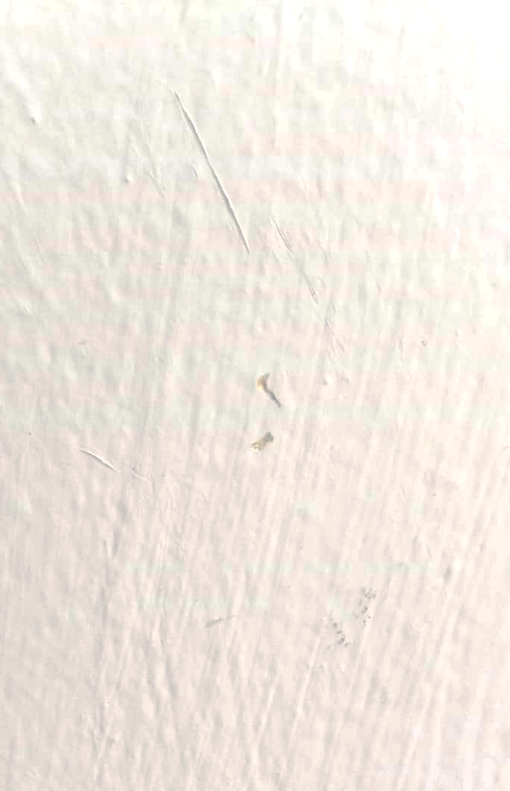
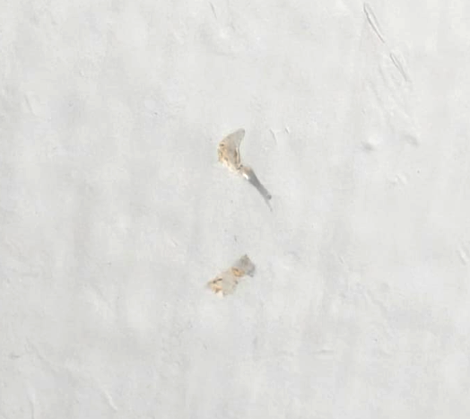
PAINT - SAQL
DEFECT DESCRIPTION / PARAMETER |  |  | Paint Damage
DEFECT IMAGE / PARAMTER |  |  | MEASURING METHOD
 |  |  | INSTRUMENT / INSPECTION METHOD |  | Visual Inspection
 |  |  | STANDING POSITION |  | Minimum 1 Meter in any direction.
APPLICABILITY |  VILLA  APARTMENT |  | LIGHTING |  | Natural / Ambient light / Artificial Light
ACCEPTABLE QUALITY LEVEL
SCENARIO / LOCATION / ZONE | Wall | Ceiling | Corners | Shadow Groove | Bulkhead | Cove Light
ACCEPTANCE LIMIT | Not Allowed | Not Allowed | Not Allowed | Not Allowed | Not Allowed | Not Allowed
REMARKS
Visual inspection of painted areas shall be carried out under natural daylight or appropriate artificial lighting from all relevant directions.
Time of inspection :Before application of the first coat of paint.
“Note: During keep-out inspection in case of any visual discrepancy identified, measurement verification shall be carried out based on the SAQL.”

Slide 9
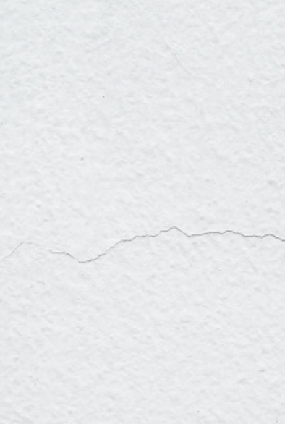
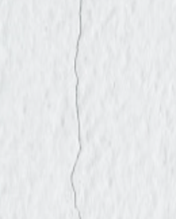
PAINT - SAQL
DEFECT DESCRIPTION / PARAMETER |  |  | Paint Crack
DEFECT IMAGE / PARAMTER |  |  | MEASURING METHOD
 |  |  | INSTRUMENT / INSPECTION METHOD |  | Visual Inspection
 |  |  | STANDING POSITION |  | Minimum 1 Meter in any direction.
APPLICABILITY |  VILLA  APARTMENT |  | LIGHTING |  | Natural / Ambient light / Artificial Light
ACCEPTABLE QUALITY LEVEL
SCENARIO / LOCATION / ZONE | Wall | Ceiling | Corners | Shadow Groove | Bulkhead | Cove Light
ACCEPTANCE LIMIT | Not Allowed | Not Allowed | Not Allowed | Not Allowed | Not Allowed | Not Allowed
REMARKS
Visual inspection of painted areas shall be carried out under natural daylight or appropriate artificial lighting from all relevant directions.
Time of inspection :Before application of the first coat of paint.
“Note: During keep-out inspection in case of any visual discrepancy identified, measurement verification shall be carried out based on the SAQL.”

Slide 10
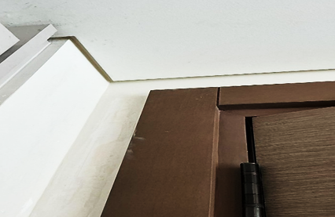
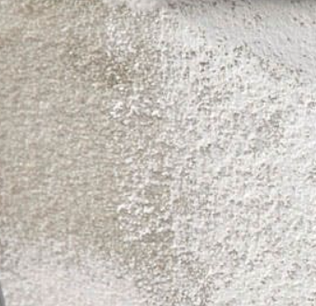


PAINT - SAQL
DEFECT DESCRIPTION / PARAMETER |  |  | Paint Touch-Up
DEFECT IMAGE / PARAMTER |  |  | MEASURING METHOD
 |  |  | INSTRUMENT / INSPECTION METHOD |  | Visual Inspection
 |  |  | STANDING POSITION |  | Minimum 1 Meter in any direction.
APPLICABILITY |  VILLA  APARTMENT |  | LIGHTING |  | Natural / Ambient light / Artificial Light
ACCEPTABLE QUALITY LEVEL
SCENARIO / LOCATION / ZONE | Wall | Ceiling | Corners | Shadow Groove | Bulkhead | Cove Light
ACCEPTANCE LIMIT | Not visible from 1 meter at any angle | Not visible from 1 meter at any angle | Not visible from 1 meter at any angle | Not visible from 1 meter at any angle | Not visible from 1 meter at any angle | Not visible from 1 meter at any angle
REMARKS
Visual inspection of painted areas shall be carried out under natural daylight or appropriate artificial lighting from all relevant directions.
Time of inspection :Before application of the first coat of paint.
“Note: During keep-out inspection in case of any visual discrepancy identified, measurement verification shall be carried out based on the SAQL.”

Slide 11


PAINT - SAQL
DEFECT DESCRIPTION / PARAMETER |  |  | Paint Bubbles
DEFECT IMAGE / PARAMTER |  |  | MEASURING METHOD
 |  |  | INSTRUMENT / INSPECTION METHOD |  | Visual Inspection
 |  |  | STANDING POSITION |  | Minimum 1 Meter in any direction.
APPLICABILITY |  VILLA  APARTMENT |  | LIGHTING |  | Natural / Ambient light / Artificial Light
ACCEPTABLE QUALITY LEVEL
SCENARIO / LOCATION / ZONE | Wall | Ceiling | Corners | Shadow Groove | Bulkhead | Cove Light
ACCEPTANCE LIMIT | Not visible from 1 meter at any angle | Not visible from 1 meter at any angle | Not visible from 1 meter at any angle | Not visible from 1 meter at any angle | Not visible from 1 meter at any angle | Not visible from 1 meter at any angle
REMARKS
Visual inspection of painted areas shall be carried out under natural daylight or appropriate artificial lighting from all relevant directions.
Time of inspection :Before application of the first coat of paint.
“Note: During keep-out inspection in case of any visual discrepancy identified, measurement verification shall be carried out based on the SAQL.”

Slide 12

PAINT - SAQL
DEFECT DESCRIPTION / PARAMETER |  |  | Improper Paint Finish
DEFECT IMAGE / PARAMTER |  |  | MEASURING METHOD
 |  |  | INSTRUMENT / INSPECTION METHOD |  | Visual Inspection
 |  |  | STANDING POSITION |  | Minimum 1 Meter in any direction.
APPLICABILITY |  VILLA  APARTMENT |  | LIGHTING |  | Natural / Ambient light / Artificial Light
ACCEPTABLE QUALITY LEVEL
SCENARIO / LOCATION / ZONE | Wall | Ceiling | Corners | Shadow Groove | Bulkhead | Cove Light
ACCEPTANCE LIMIT | Not visible from 1 meter at any angle | Not visible from 1 meter at any angle | Not visible from 1 meter at any angle | Not visible from 1 meter at any angle | Not visible from 1 meter at any angle | Not visible from 1 meter at any angle
REMARKS
Visual inspection of painted areas shall be carried out under natural daylight or appropriate artificial lighting from all relevant directions.
Time of inspection :Before application of the first coat of paint.
“Note: During keep-out inspection in case of any visual discrepancy identified, measurement verification shall be carried out based on the SAQL.”

Slide 13
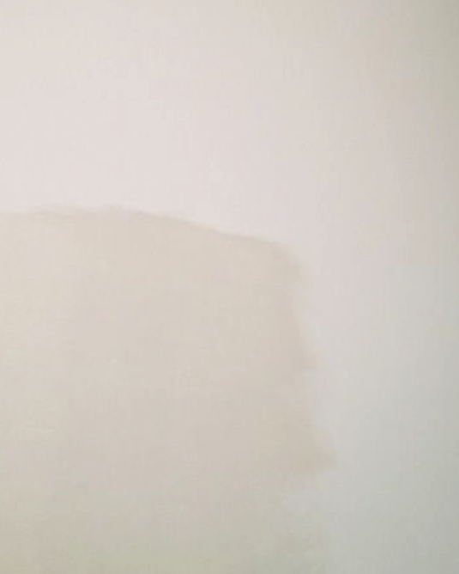
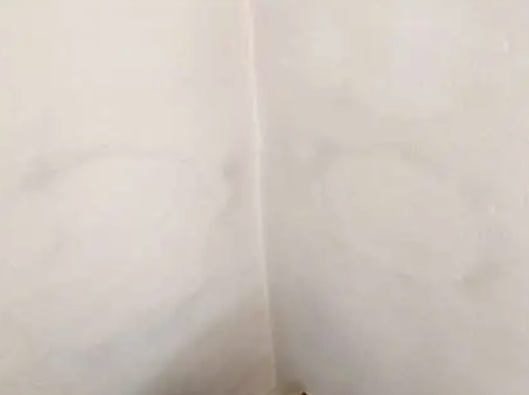
PAINT - SAQL
DEFECT DESCRIPTION / PARAMETER |  |  | Paint Shade Variation
DEFECT IMAGE / PARAMTER |  |  | MEASURING METHOD
 |  |  | INSTRUMENT / INSPECTION METHOD |  | Visual Inspection
 |  |  | STANDING POSITION |  | Minimum 1 Meter in any direction.
APPLICABILITY |  VILLA  APARTMENT |  | LIGHTING |  | Natural / Ambient light / Artificial Light
ACCEPTABLE QUALITY LEVEL
SCENARIO / LOCATION / ZONE | Wall | Ceiling | Corners | Shadow Groove | Bulkhead | Cove Light
ACCEPTANCE LIMIT | Not visible from 1 meter at any angle | Not visible from 1 meter at any angle | Not visible from 1 meter at any angle | Not visible from 1 meter at any angle | Not visible from 1 meter at any angle | Not visible from 1 meter at any angle
REMARKS
Visual inspection of painted areas shall be carried out under natural daylight or appropriate artificial lighting from all relevant directions.
Time of inspection :Before application of the first coat of paint.
“Note: During keep-out inspection in case of any visual discrepancy identified, measurement verification shall be carried out based on the SAQL.”

Slide 14
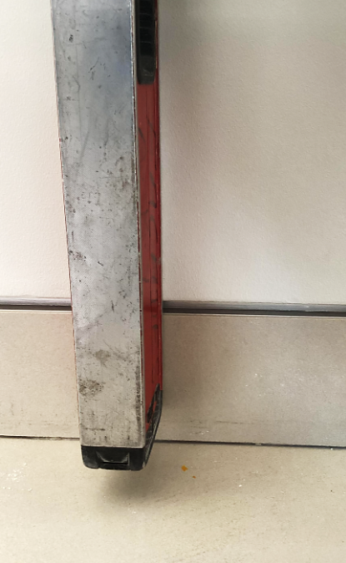
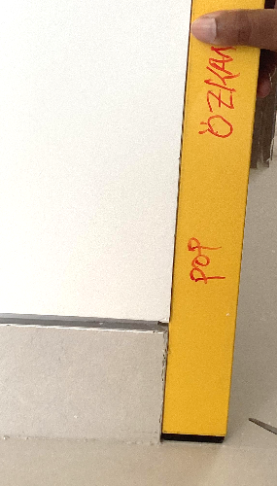
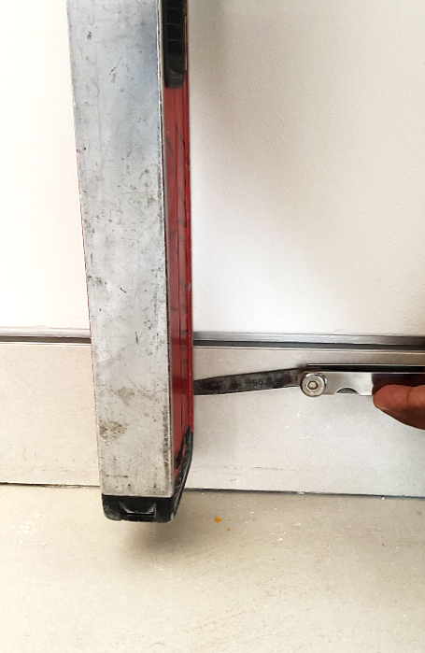
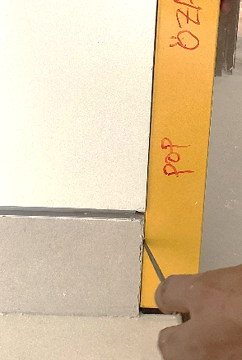
PAINT - SAQL
DEFECT DESCRIPTION / PARAMETER |  |  | Skirting vs Wall paint flushness
DEFECT IMAGE / PARAMTER |  |  | MEASURING METHOD
 |  |  | INSTRUMENT / INSPECTION METHOD |  | Straight Edge & Feeler gauge
 |  |  | STANDING POSITION |  | As required
APPLICABILITY |  VILLA  APARTMENT |  | LIGHTING |  | Natural / Ambient light / Artificial Light
ACCEPTABLE QUALITY LEVEL
SCENARIO / LOCATION / ZONE | Wall | Ceiling | Corners | Shadow Groove | Bulkhead | Cove Light
ACCEPTANCE LIMIT | 0.5 mm Max | NA | 0 mm | NA | NA | NA
REMARKS
Place 3-meter straight edge flat on the skirting against the wall paint surface.
Confirm that the gap measured with a feeler gauge does not exceed 0.5 mm
Time of inspection :Before application of the first coat of paint.
Wall Area
Corner Area
“Note: During keep-out inspection in case of any visual discrepancy identified, measurement verification shall be carried out based on the SAQL.”

Slide 15
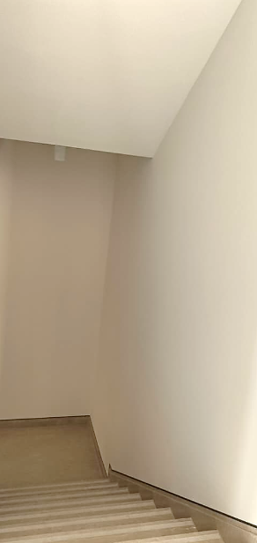
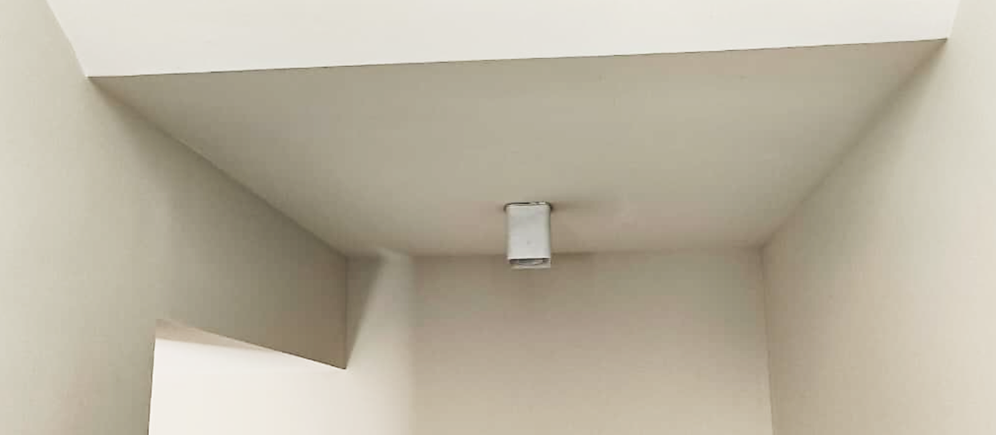
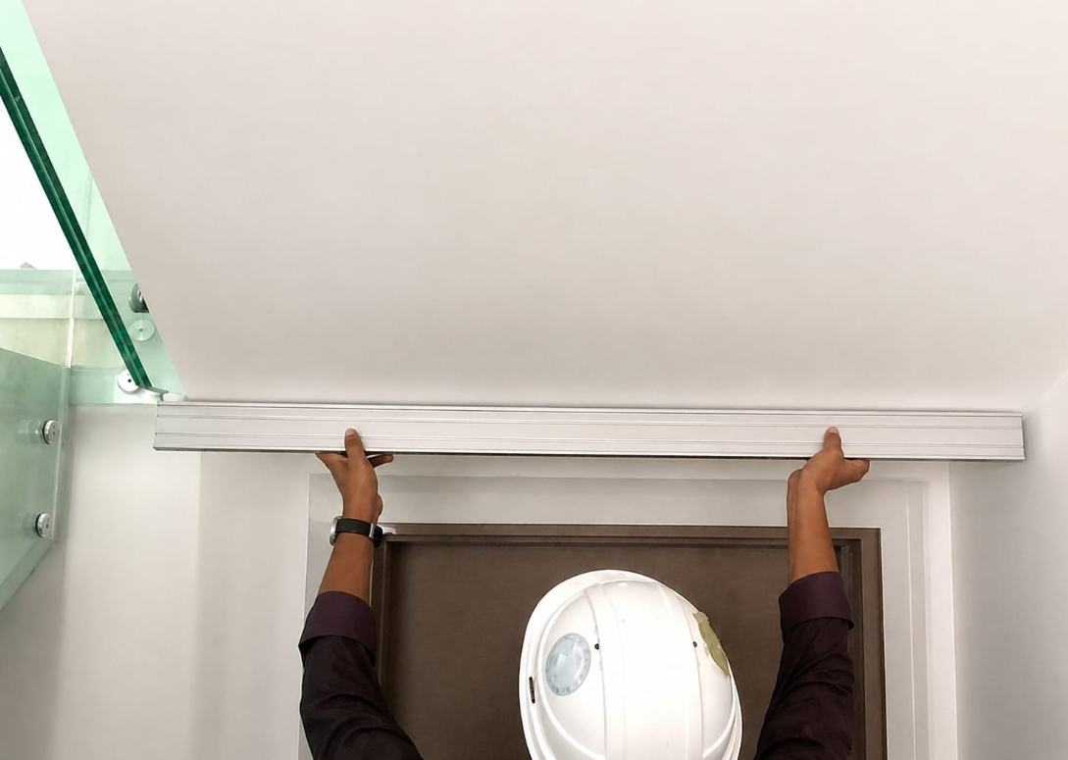
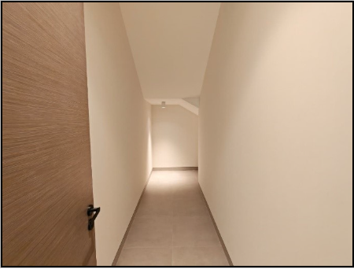
PAINT - SAQL
DEFECT DESCRIPTION / PARAMETER |  |  | Paint - Staircase bottom undulation (Flatness)
DEFECT IMAGE / PARAMTER |  |  | MEASURING METHOD
 |  |  | INSTRUMENT / INSPECTION METHOD |  | Straight Edge, Feeler gauge
 |  |  | STANDING POSITION |  | As required.
APPLICABILITY |  VILLA  APARTMENT |  | LIGHTING |  | Natural / Ambient light / Artificial Light
ACCEPTABLE QUALITY LEVEL
SCENARIO / LOCATION / ZONE | Wall | Ceiling | Corners | Shadow Groove | Bulkhead | Cove Light
ACCEPTANCE LIMIT | NA | 1mm / Sofit width | NA | NA | NA | NA
REMARKS
Place the straight edge flat against the painted surface at the staircase bottom.
Ensure the flatness deviation does not exceed 1 mm along the full length.
Time of inspection :Before application of the first coat of paint.
“Note: During keep-out inspection in case of any visual discrepancy identified, measurement verification shall be carried out based on the SAQL.”

Slide 16

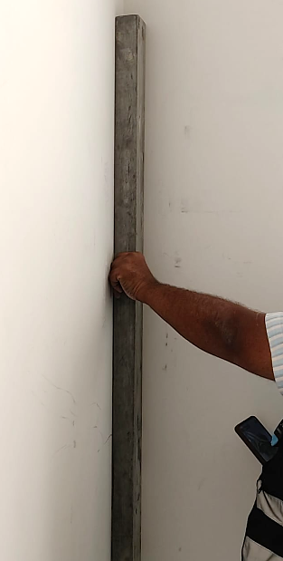
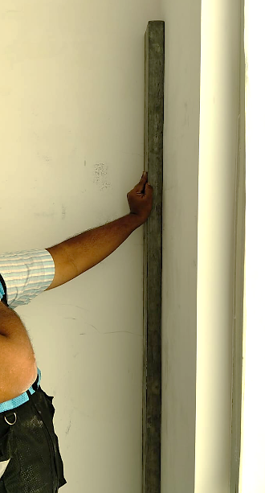
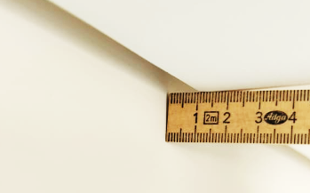
PAINT - SAQL
DEFECT DESCRIPTION / PARAMETER |  |  | Paint - Corner Waviness
DEFECT IMAGE / PARAMTER |  |  | MEASURING METHOD
 |  |  | INSTRUMENT / INSPECTION METHOD |  | Straight Edge, Feeler gauge
 |  |  | STANDING POSITION |  | As required.
APPLICABILITY |  VILLA  APARTMENT |  | LIGHTING |  | Natural / Ambient light / Artificial Light
ACCEPTABLE QUALITY LEVEL
SCENARIO / LOCATION / ZONE | Wall | Ceiling | Corners | Shadow Groove | Bulkhead | Cove Light
ACCEPTANCE LIMIT | NA | NA | 1 mm | 1 mm (Wall side) 0mm (Metal Side) | 0 mm | NA
REMARKS
Wall
Wall
Shadow Groove
Place the 3‑meter straight edge level flat against the painted wall surface in one direction.
Reposition the 3‑meter straight edge level flat against the wall in the perpendicular direction.
Check and confirm flatness deviation over the full length of the straight edge.
Time of inspection :Before application of the first coat of paint.
“Note: During keep-out inspection in case of any visual discrepancy identified, measurement verification shall be carried out based on the SAQL.”

Slide 17
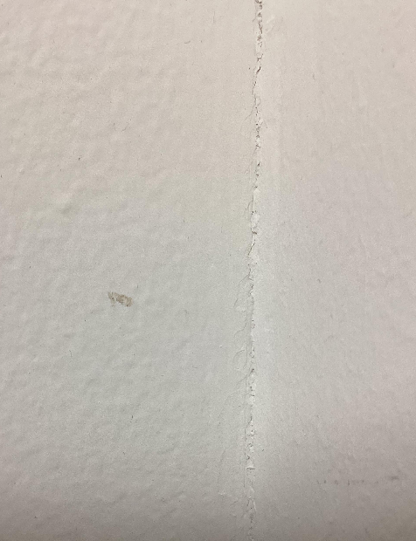
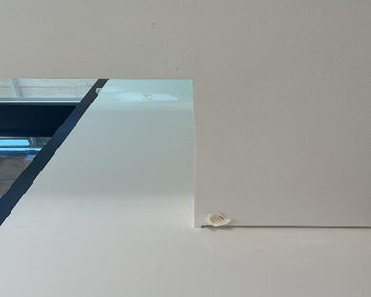
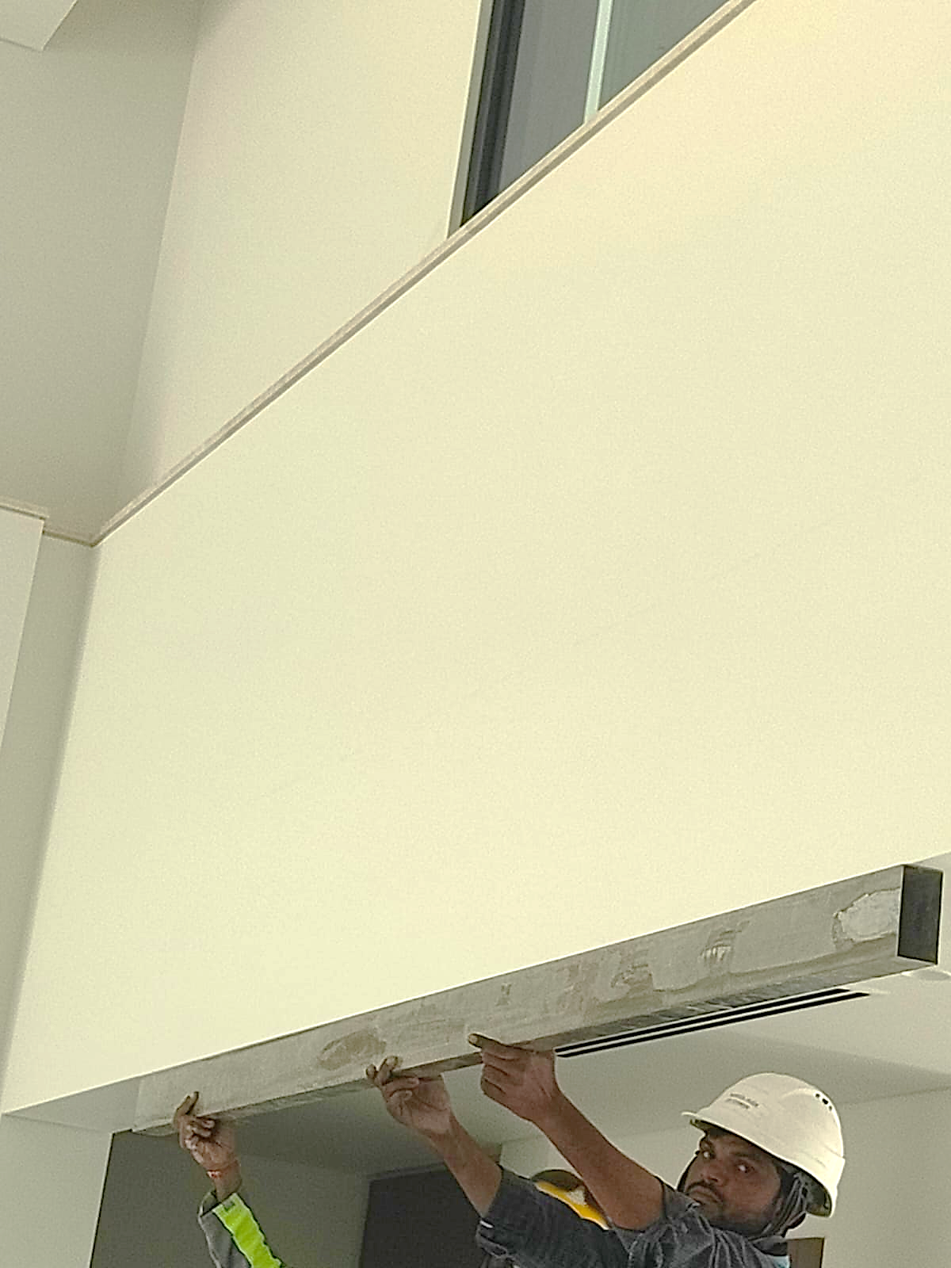
PAINT - SAQL
DEFECT DESCRIPTION / PARAMETER |  |  | Paint – Edge Undulation
DEFECT IMAGE / PARAMTER |  |  | MEASURING METHOD
 |  |  | INSTRUMENT / INSPECTION METHOD |  | Straight Edge.
 |  |  | STANDING POSITION |  | As required.
APPLICABILITY |  VILLA  APARTMENT |  | LIGHTING |  | Natural / Ambient light / Artificial Light
ACCEPTABLE QUALITY LEVEL
SCENARIO / LOCATION / ZONE | Wall | Ceiling | Corners | Shadow Groove | Bulkhead | Cove Light
ACCEPTANCE LIMIT | NA | NA | 0.5mm for 3 meter | NA | 0 mm | NA
REMARKS
Place the straight edge level flush against the soffit surface.
Align it fully along the edge, ensuring continuous contact.
Check for gaps to confirm straightness and level.
Time of inspection :Before application of the first coat of paint.
Wall (Internal)Corner Undulation
Ceiling Corner(Exposed corner)
Undulation
“Note: During keep-out inspection in case of any visual discrepancy identified, measurement verification shall be carried out based on the SAQL.”

Slide 18
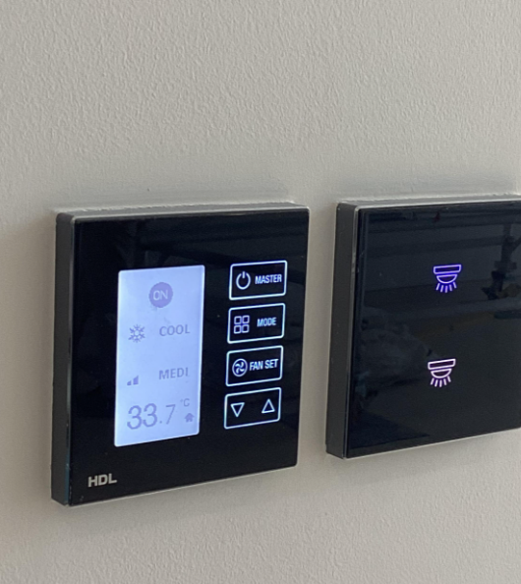
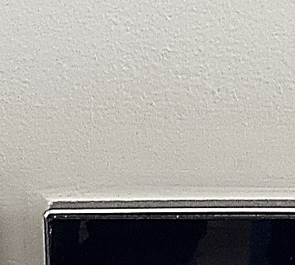
PAINT - SAQL
DEFECT DESCRIPTION / PARAMETER |  |  | Paint pattern – Texture vs Smooth (Around MEP Fixtures)
DEFECT IMAGE / PARAMTER |  |  | MEASURING METHOD
 |  |  | INSTRUMENT / INSPECTION METHOD |  | Visual Inspection
 |  |  | STANDING POSITION |  | Minimum 1 Meter in any direction.
APPLICABILITY |  VILLA  APARTMENT |  | LIGHTING |  | Natural / Ambient light / Artificial Light
ACCEPTABLE QUALITY LEVEL
SCENARIO / LOCATION / ZONE | Wall | Ceiling | Corners | Shadow Groove | Bulkhead | Cove Light
ACCEPTANCE LIMIT | Not Allowed | NA | NA | NA | NA | NA
REMARKS
Visual inspection of painted areas shall be carried out under natural daylight or appropriate artificial lighting from all relevant directions.
Time of inspection :Before application of the first coat of paint.
“Note: During keep-out inspection in case of any visual discrepancy identified, measurement verification shall be carried out based on the SAQL.”

Slide 19
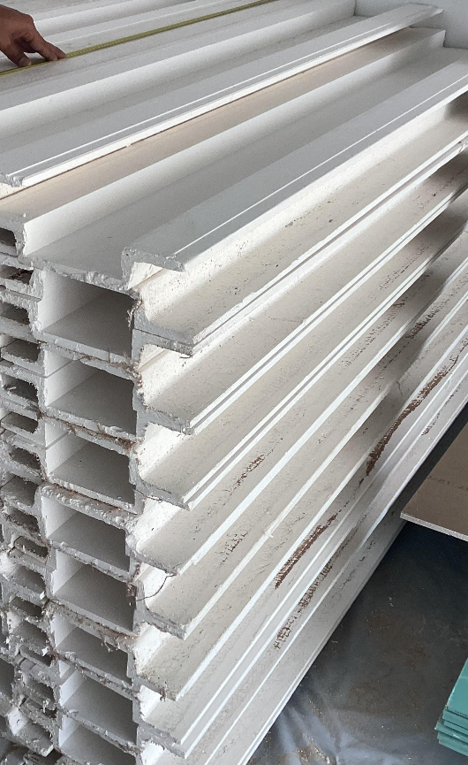
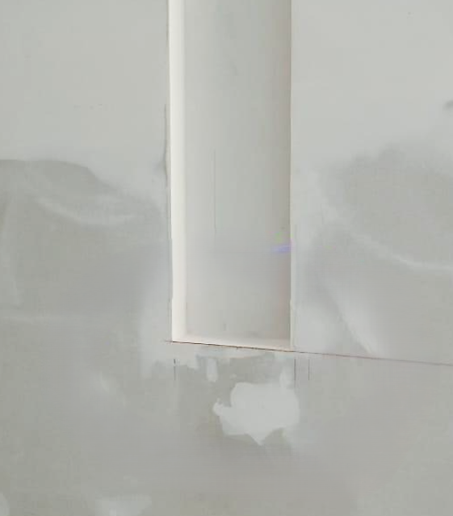
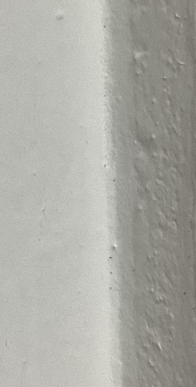
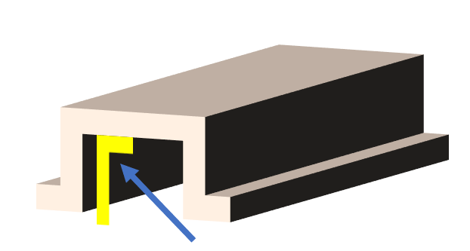
PAINT - SAQL
DEFECT DESCRIPTION / PARAMETER |  |  | Paint - GRG panel line verticality and corner
DEFECT IMAGE / PARAMTER |  |  | MEASURING METHOD
 |  |  | INSTRUMENT / INSPECTION METHOD |  | Putty & Feeler Gauge
 |  |  | STANDING POSITION |  | As required.
APPLICABILITY |  VILLA  APARTMENT |  | LIGHTING |  | Natural / Ambient light / Artificial Light
ACCEPTABLE QUALITY LEVEL
SCENARIO / LOCATION / ZONE | Wall | Ceiling | Corners | Shadow Groove | Bulkhead | Cove Light
ACCEPTANCE LIMIT | NA | 0.5mm for 3mtr | NA | NA | NA | NA
REMARKS
Place the straight edge flat on the edge against the wall paint surface.
Confirm that the gap measured with a feeler gauge does not exceed 0.5 mm
Time of inspection :Before application of the first coat of paint.
“Note: During keep-out inspection in case of any visual discrepancy identified, measurement verification shall be carried out based on the SAQL.”

Slide 20
Thank you
In case any details are required, please contact the QM-QAQC@sobha-me.com.

